Slide 1

Multi-Objective Portfolio
Optimisation
Using Reinforcement Learning & Evolutionary Algorithms
Matthew Woodcock • Supervised by Professor Peter Tino
PPO | NSGA-II | GARCH | 11-Asset Universe | Significance Testing

Slide 2
Project Introduction & Objectives
Project Overview
Portfolio management requires balancing return and risk across changing market conditions, yet most classical approaches assume stability. This project builds and evaluates a reinforcement learning agent and an evolutionary optimiser, both capable of dynamically adapting to shifting market conditions, tested rigorously on a realistic asset universe with genuine transaction costs and significance testing.
Key Objectives
01
RL vs Evolutionary Optimisation
Does PPO outperform NSGA-II, and under what conditions?
02
Multi-Objective Evaluation
Pareto-based policy selection across return, maximum drawdown, and concentration
03
Statistical Rigour
Significance testing across 50 runs, plus an additional held-out test period to confirm results generalise
04
Volatility Integration
Test whether GARCH volatility forecasts improve learned policies

Slide 3



The Problem & Motivation
Non-Stationary
Markets
Classical Methods
Fail
Adaptive
Solution
Statistical patterns in historical data do not reliably persist. Markets shift suddenly without warning, making fixed-parameter models unreliable.
Markowitz mean-variance optimisation assumes a fixed covariance matrix, which is structurally incompatible with regime changes in non-stationary markets.
RL frames portfolio management as a Markov Decision Process, learning adaptive behaviour directly from market experience rather than assuming stability.
11
13.5 years
0.1%
207
747
Assets (+ Cash)
Market Data
Transaction Cost
Small Test Days
Large Test Days
Daily price data spans June 2012 to December 2025, covering multiple distinct market regimes.

Slide 4
System Architecture & Methodology
Data Preparation
Strategy Training
Test Evaluation
Post-Hoc MOO
Tiingo API
Adjusted Prices
GARCH Volatility
PPO (SB3)
8 RL Variants
NSGA-II Static & Rolling
Held-Out Test Set
Sharpe, MDD, HHI
Transaction Costs
Pareto Dominance
Return, HHI, MDD
epsilon = 0.005
Reinforcement Learning (PPO)
Evolutionary Optimisation (NSGA-II)
Rewards: PureReturn, LogReturn, HighHHI, LowVolatility
Observation: 40-day normalised price window +/- GARCH forecasts
Action: Softmax continuous weight vector (long-only)
Selection: EvalCallback picks best checkpoint on eval set
Static: Train on eval set, pop=80, gen=50, fixed action
Rolling: Retrain every 10 days on most recent 40-day window
Objectives: Portfolio return + Max Drawdown (2-obj Pareto)
Selection: Distance-to-utopia (0.65 return weight, 0.35 MDD)

Slide 5
Key Results
2.577
2.21x
50/50
100%
Best Sharpe Ratio
Best Return
Statistically Significant
RL Wins (Large)
Small configuration best run
Large configuration
H₀: Sharpe ratio ≤ 0, all Large runs
NSGA-II never dominated
Configuration | Mean Return | Mean Sharpe | Mean MDD | Mean p-value | Mean HHI | Transaction Cost %
Large (747 days) | 1.954 +/- 0.254 | 1.265 +/- 0.142 | -0.150 +/- 0.034 | 0.012 +/- 0.009 | 0.270 | 9.38%
Augmented Large | 1.881 +/- 0.247 | 1.232 +/- 0.110 | -0.148 +/- 0.040 | 0.012 +/- 0.008 | 0.198 | 7.05%
Baseline Large | 1.739 | 1.182 | -0.141 | 0.014 | 0.083 | 0.0%
Small (207 days) | 1.225 +/- 0.056 | 1.523 +/- 0.316 | -0.077 +/- 0.022 | 0.080 +/- 0.040 | 0.405 | 2.73%
Augmented Small | 1.224 +/- 0.072 | 1.412 +/- 0.333 | -0.084 +/- 0.023 | 0.094 +/- 0.042 | 0.387 | 2.37%
Baseline Small | 1.136 | 1.077 | -0.067 | 0.147 | 0.083 | 0.0%
Augmented configurations have portfolio weights added to the agent's observation space, allowing them to see their current portfolio allocations.

Slide 6




Challenges
Weak Significance Against Equal-Weight Baseline
Offline PPO Deployment Limitation
Small achieved best Sharpe but only 2/50 runs were statistically significant against the equal-weight bootstrap baseline, with 0/50 significant under Jobson-Korkie. Large had 0/50 runs that were statistically significant against the equal-weight baseline under either test.
The PPO agent is frozen after training and cannot update its weights during testing. Over a 3-year Large test period, structural market changes after training cannot be adapted to without periodic retraining.
GARCH Zero-Correlation Approximation
DCC-GARCH Did Not Improve Results
The LowVolatility reward computes portfolio variance assuming zero cross-asset correlation. This underestimates true risk when assets are positively correlated, which commonly occurs during market stress.
DCC-GARCH modelled time-varying correlations across all 11 assets but showed no measurable improvement over independent GARCH(1,1). The added covariance complexity likely increased reward noise without providing a cleaner learning gradient for PPO.

Slide 7
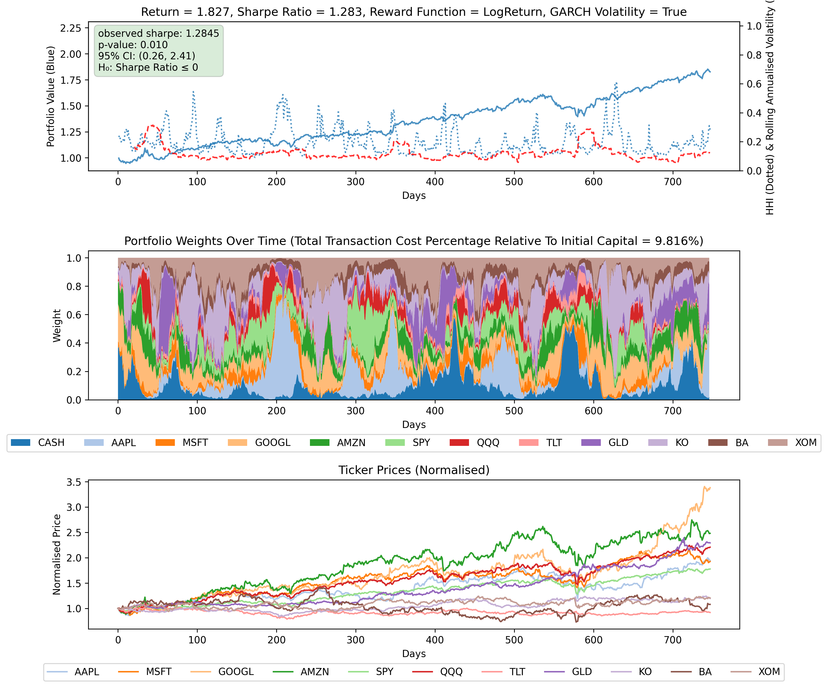
Adaptive Behaviour Under Market Stress
Days 550–600: Agent shifts from equities into cash and gold ahead of the August 2024 Bank of Japan sell-off, demonstrating genuine learned risk awareness.

Slide 8
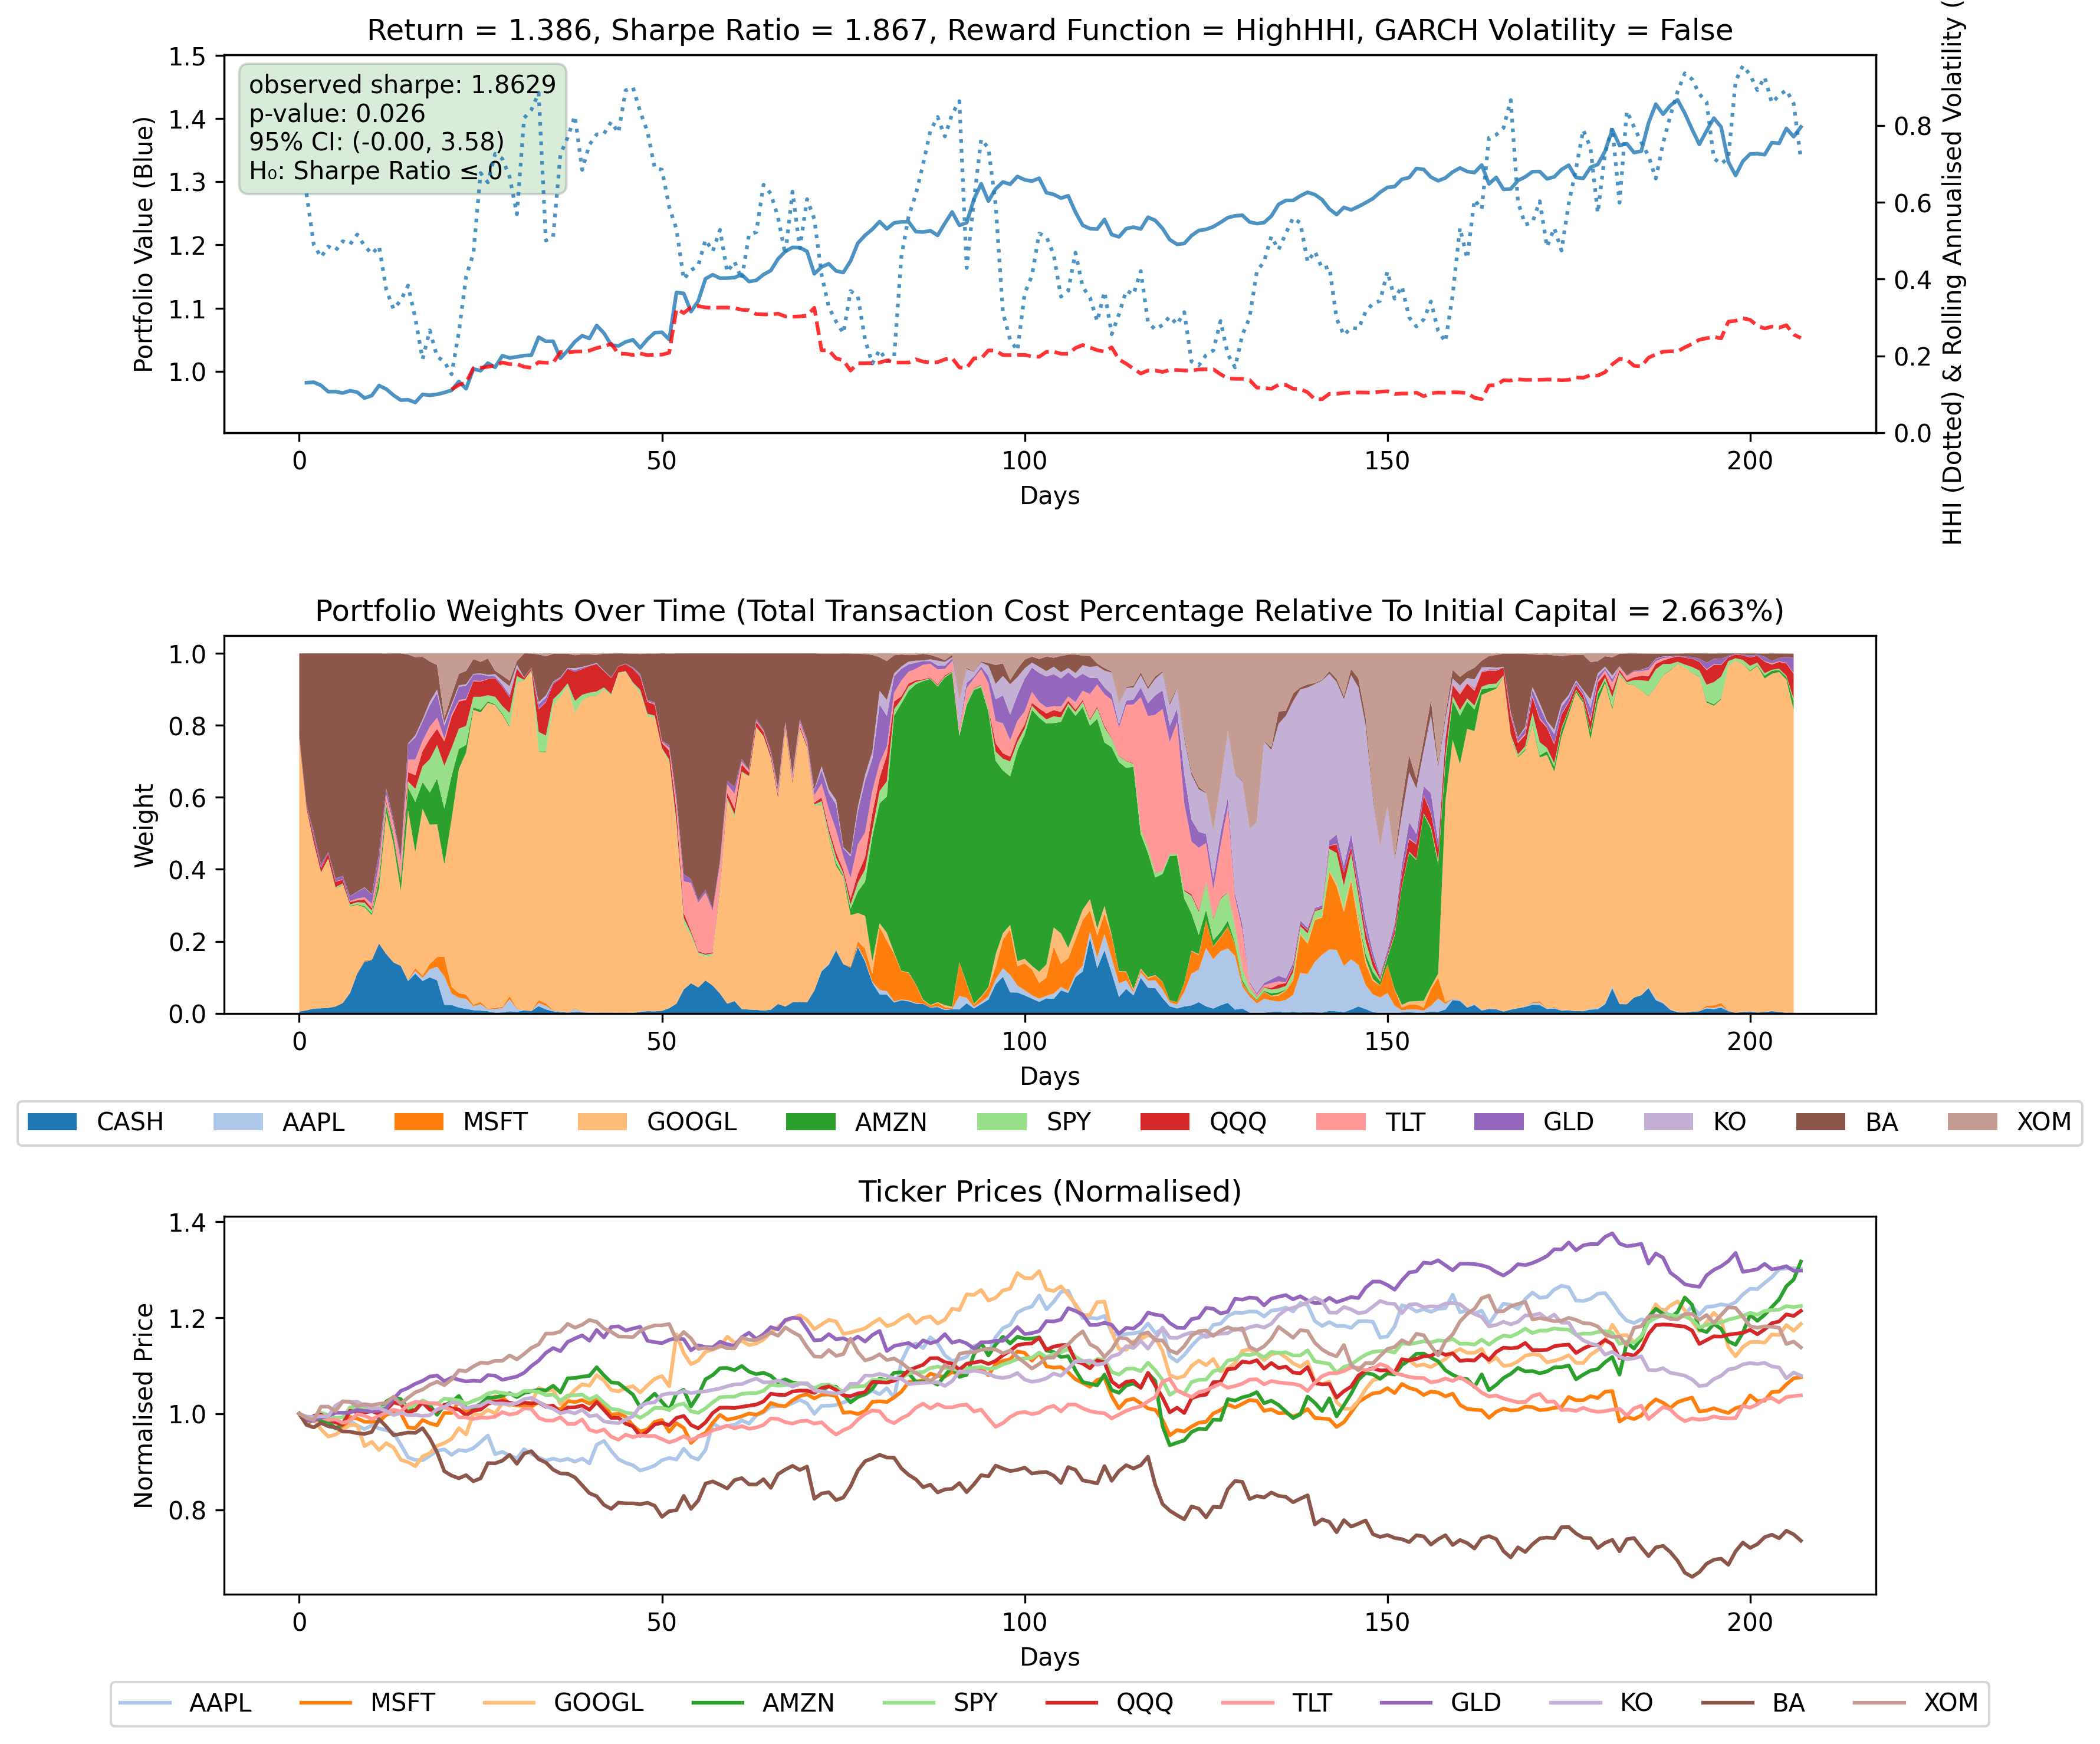
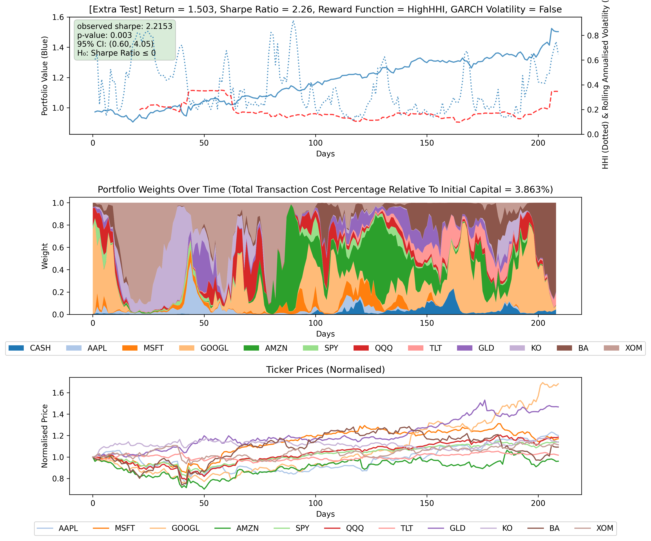
Out-of-Sample Robustness
Standard Test Window
Extra Test Window (Same Frozen Policy)
Frozen HighHHI policy generalises to an unseen test period, ruling out overfitting to a single market regime.

Slide 9




Achievements & Conclusions
RL Dominates with Sufficient Training Data
Robust Post-Hoc MOO Framework
In the Large configuration RL was selected by the Pareto filter in 100% of 50 runs, all achieving p < 0.05 against risk-free rate, confirming that PPO learns robust adaptive policies that consistently outperform both NSGA-II and the passive equal-weight benchmark.
The 3-objective Pareto dominance filter (return, MDD, HHI) provides a principled selection mechanism across stochastic PPO runs. It avoids collapsing trade-offs into a single metric and is well-suited to the variance inherent in RL training.
Rolling NSGA-II as a Safety Net
Practical & Realistic Evaluation
NSGA-II provided a valuable fallback in 7/50 Small config runs when RL underperformed, delivering consistent, low-turnover, concentrated portfolios. However, it was never selected in runs where RL succeeded, confirming its role as backup rather than rival.
All results are net of a genuine 0.1% institutional brokerage fee. The best Large run achieved 2.21x return and Sharpe 1.68 over 3 years, with portfolio weights visibly adapting to market stress events including the August 2024 global sell-off.
Future Work: Periodic PPO Retraining | Online RL | Live Market Deployment

Slide 10
00001111 SR = 1
1111 0000 0011
0000 0000 SR = 0
1111 1111 SR = 2

